Slide 1
CHAPTER ONE
OVERVIEW
Prepared By: Marta G. (MSc.)

Slide 2
Computer system structure
A system is a collection of elements or components that are organized for a common purpose.
In other word system is a group of interacting or interrelated entities that form a unified whole.
Computer system is a collection of entities( hardware, software and liveware) that are designed to receive, process, manage and present information in a meaningful format.
Therefore, Computer system structure can be divided into three components:
Hardware
Software and
liveware

Slide 3
Hardware
It is made up of a number of electronic devices connected together. It is a physical/ tangible part of a computer. It consist of:
Input devices
Output devices
System unit
Secondary storage device and
communication network.

Slide 4
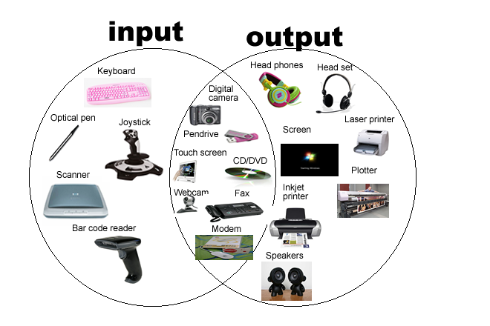
Cont….
Input device enables users to enter data or programs into a computer. This device converts data or instructions from a form suitable to human beings to one understandable by the computer.
Output devices used to provide processed information to user. Hence, it converts data from machine understandable to human understandable language.

Slide 5
System unit
It also known as a "tower" or "chassis," is the main part of a desktop computer.

Slide 6
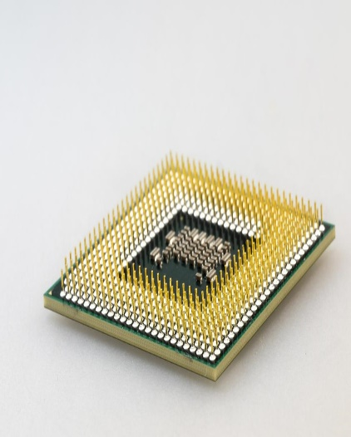
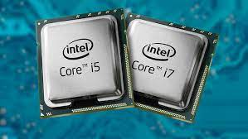
CPU (Central Processing Unit)
The CPU or processor is a microprocessor chip (a silicon chip with complex circuits) found on the motherboard. The mothered is the main board located inside the system unit containing the different chips of the computer.
All computer operations are under the control of the CPU, which has the following functions:
It controls the transmission of data from input devices to memory
It processes the data held in main memory
It controls the transmission of information from main memory to output devices etc.
The CPU has got three main components: CU, ALU(Arithmetic logic unit) and registers.

Slide 7
Cont…
Control unit
It controls the flow of data & instructions between the CPU & Memory, between the CPU & Input/ Output devices, etc.
It is responsible for loading, interpreting the individual instructions that comprise the computer program.
decoding the instructions within a computer
sequencing the reading and writing of data within the CPU and externally on the data bus
controlling the sequence in which instructions are executed
controlling the operations performed by the ALU

Slide 8
Cont…
ALU
The ALU is responsible for carrying out arithmetical and logical operations like addition, subtraction, comparison etc.
Register
It is a small high speed memory which is used to store temporary results and control information. This memory consists of a number of registers, each performing a specific function.
Instruction Register:- Holds a copy of current instructions
Program Counter:- Points to the next instruction to be executed in memory
Data Register:- Used for store data to be executed temporarily

Slide 9
Memory
It is the work area of our computer system. There are two categories of memory: Primary and Secondary.
Primary Memory
It is the memory that is intimately associated with the actual working of the computers.
This includes memory that holds the start up routines as well as the current program & data it is working with.
Mainly, there are two types of primary memory: RAM and ROM

Slide 10
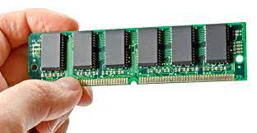
Cont…
RAM is a memory mainly used to store instruction and data currently used by the central processing unit.
As a result, it is called working storage. And it is this memory that has a direct relationship with the ALU and CU, which are components of the central processing unit.
RAM is a memory that is logically divided into many equal sized cells called memory locations. Memory locations will be accessed using their addresses.
Characteristics of RAM
RAM is volatile (any data on RAM will be lost when power is turned off)
It is a read(retrieve) write(store) memory
It is up gradable
It can be randomly accessed

Slide 11
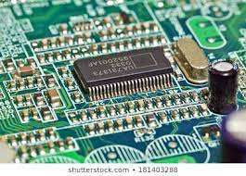
Cont…
ROM is a memory used to store critical instructions that are used to boot (start) the computer.
ROM stores “firmware,” which is permanent software that’s hard-wired with integrated circuits.
The BIOS (Basic Input Output System) is an example of a program that is stored in ROM. The BIOS runs as soon as the computer is switched on. It checks that the hardware is functioning correctly then loads the computer's operating system. Because the BIOS is always needed it is stored in ROM.
Characteristics of ROM
It is non-volatile
It is a read only memory
It can be randomly accessed

Slide 12
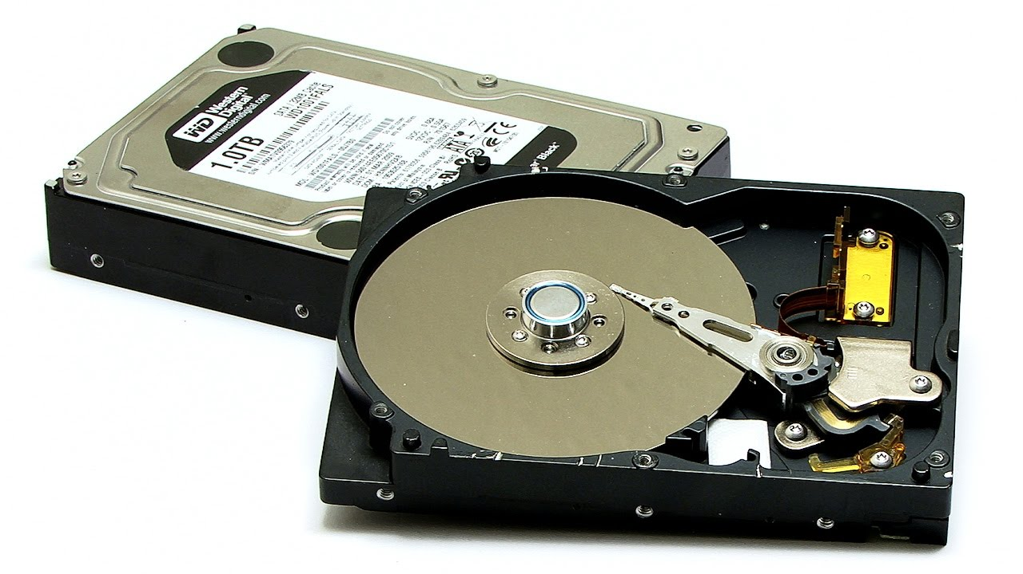
Secondary storage device
Secondary Memory
secondary storage devices enable to store data permanently.
Consists of various devices that are able to store data & programs even when the power is off.
Access type, storage capacity and removability determines secondary storage devices
Example: Hard drives, Floppy Drives, CD & DVD etc.
Hard disk drives are commonly used as the main storage device in a computer. HDDs often store operating system, software programs and other files

Slide 13
Communication network
A communication network called Bus/Cables, which links all the elements of the System and connects the System to the external world.

Slide 14
Software
It is a set of programs that tells a computer what to do, when to do and how to do.
It is a set of programs, which is designed to perform a well-defined function. A program is a sequence of instructions written to solve a particular problem.
They are classified into two classes namely: system software and application software.

Slide 15
System software
System software consists of instructions or programs that are used to manage the hardware resources of a computer.
It placed between the hardware and the application software. I.e. it is used as an intermediate for the communication between the hardware and the application software of a computer system.
Operating system software: is a set of programs that controls and supervises the overall operation of the computer.
System development software (Language software): are used by the programmers to develop application programs.

Slide 16
Application software
It define the ways in which the system resources are used to solve the computing problems of the users.
Application software products are designed to satisfy a particular need of a particular environment.
Application software is a type of software that placed between the user and the system software and allows the user to perform a certain activity- such as creating a document or editing a graphic image.
E.g. Microsoft word, web browsers, database systems, video games, Microsoft Excel, e.t.c

Slide 17
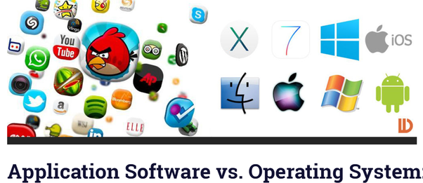

Slide 18
Cont…
Liveware: is the computer user. Also kwon as orgwareor the humanware. The user commands the computer system to execute on instructions.

Slide 19
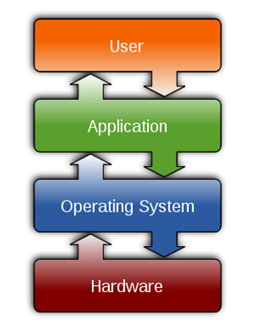
Four Components of a Computer System

Slide 20
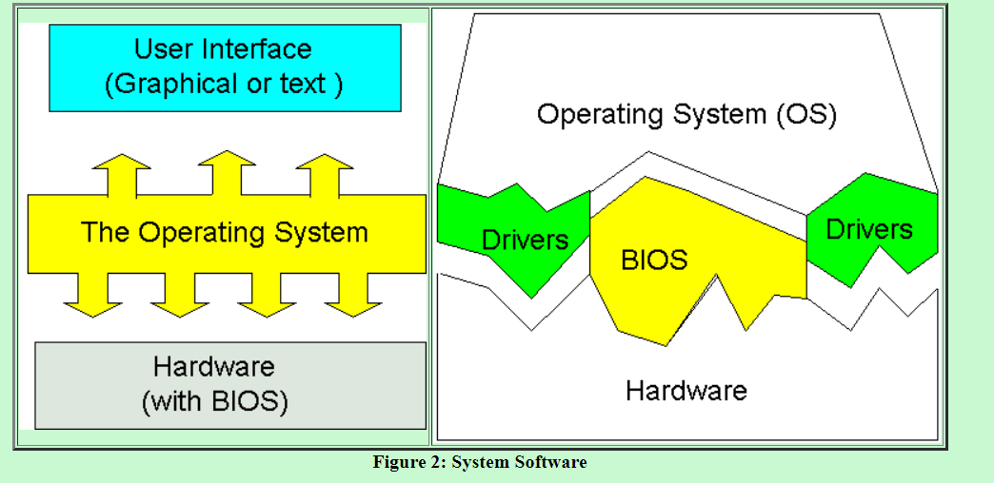

Slide 21
What is operating system?
OS acts as an interface between the application programs and the machine hardware.
Every computer system must have at least one operating system to run other programs.
A program that acts as an intermediary between a user of a computer and the computer hardware.
Applications like Browsers, MS Office, Notepad Games, etc., need some environment to run and perform its tasks.
The OS helps you to communicate with the computer without knowing how to speak the computer's language.

Slide 22
Operating System Definition
OS is a resource allocator
As a resource allocator, it acts as mgr of resources(hardware and software) and allocates them to specific programs and users as necessary for tasks.
Decides between conflicting requests for efficient and fair resource use
Resource management includes multiplexing (sharing) resources in two different ways: in time and in space
OS is a control program
Controls execution of programs to prevent errors and improper use of the computer

Slide 23
Main functions of OS
Manage the computer's resources, such as the central processing unit, memory, disk drives, and printers
Establish a user interface
The program that users interact with, usually called the shell when it is text based and the GUI (Graphical User Interface)—which is pronounced "gooey"— when it uses icons, is actually not part of the operating system although it uses the operating system to get its work done.
Execute and provide services for applications software.

Slide 24
Example of operating system
Microsoft Windows (including Windows 95, Windows Vista, Windows 7/8/10, etc.)
Apple macOS
Google's Android OS.
Apple iOS.
Linux Operating System.

Slide 25
Objectives of Operating Systems
To make the computer system convenient to use in an efficient manner.
To hide the details of the hardware resources from the users.
To provide users a convenient interface to use the computer system.
To act as an intermediary between the hardware and its users, making it easier for the users to access and use other resources.
To manage the resources of a computer system.
To keep track of who is using which resource, granting resource requests, and mediating conflicting requests from different programs and users.
To provide efficient and fair sharing of resources among users and programs.

Slide 26
Dual-mode operation
It forms the basis for I/O protection, memory protection and CPU protection.
In dual-mode operation, there are two separate modes: monitor mode (also called 'system mode' and 'kernel mode') and user mode.
In monitor mode, the CPU can use all instructions and access all areas of memory.
In user mode, the CPU is restricted to unprivileged instructions and a specified area of memory. User code should always be executed in user mode and the OS design ensures that it is.
When responding to system calls, other traps/exceptions, and interrupts, OS code is run. The CPU automatically switches to monitor mode whenever an interrupt or trap occurs. So, the OS code is run in monitor mode.
With the mode bit, we are able to distinguish between a task that is executed on behalf of the OS and one that is executed on behalf of the user.

Slide 27
Some important concepts
bootstrap program:- is loaded at power-up or reboot
It stored on the ROM.
The first code that is executed when the computer system is started
When the computer is turned on, the operating system will be loaded from the hard drive into the computer's memory, thus making it available for use, it is known as bootstrapping.
At system boot time, the HW starts in kernel mode.

Slide 28
Cont…
OS is triggered in two ways
Interrupt: are signals sent to the CPU by external devices, normally I/O devices. They tell the CPU to stop its current activities and execute the appropriate part of the CPU.
Eg: infinite loop, division by zero
System call: Direct “call” from a user program (software) (library)
process control: end, abort, load, execute, create process, terminate process, allocate and free memory and e.t.c
device management: request device, release device and e.t.c

Slide 29
Operating-System Functions
Memory Management
Processor Management
Device Management
File Management
Security and protection

Slide 30
Memory management
An Operating System performs the following functions for Memory Management:
It helps you to keep track of primary memory.
Determine what part of it are in use by whom, what part is not in use.
In a multiprogramming system, the OS takes a decision about which process will get Memory and how much.
Allocates the memory when a process requests
It also de-allocates the Memory when a process no longer requires or has been terminated.

Slide 31
Process management
Every software application program has one or more processes associated with them when they are running.
Functions of process management in OS includes:
Process creation and deletion.
Suspension and resumption.
Allocates the processor (CPU) to a process
De-allocates processor when a process is no longer required.
Communication process
Synchronization process

Slide 32
Device management
Keeps tracks of all devices. The program responsible for this task is known as the I/O controller.
Decides which process gets the device when and for how much time.
It offers buffer caching system
It provides general device driver code (Device driver is a computer program that operates or controls a particular type of device )
It provides drivers for particular hardware devices.
Allocates the device in the most efficient way.
De-allocates devices.

Slide 33
File management
A file is a set of related information which should define by its creator.
It commonly represents programs, both source and object forms, and data.
Data files can be numeric, alphabetic, or alphanumeric.
The operating system has the following important given activities in connections with file management:
File and directory creation and deletion
For manipulating files and directories
Mapping files onto secondary storage
Backup files on stable storage media

Slide 34
Security and protection
The various processes in an operating system need to be secured from each other's activities.
For example, Memory addressing hardware helps you to confirm a process can be executed within its own address space. The time ensures that no process has control of the CPU without renouncing it.

Slide 35
Cont…
Here, are some other important activities of OS:
The user's program can't execute I/O operations directly. The operating system should provide some medium to perform this.
OS checks the capability of the program to read, write, create, and delete files.
OS facilitates an exchange of information between processes executing on the same or different systems.
OS components help you to makes sure that you get the correct computing by detecting errors in the CPU and memory hardware.

Slide 36
Design issues
Efficiency
Most I/O devices slow compared to main memory(and the CPU)
Use of multiprogramming allows for some processes to be waiting on I/O while another process executes
Often I/O still cannot keep up with processor speed
Swapping may used to bring in additional Ready processes
Optimize I/O efficiency – especially Disk & Network I/O

Slide 37
Cont…
Robustness
The system is robust if the addition of a feature doesn't cause the breakdown of a previous feature.
In the case of a robust design, there is no implication that other parts of the design (or features) would be shaped by the addition of a new one... to the contrary, robustness implies a certain rigidity, such that the original features will be there no matter what you change in other areas.
In a good, robust OS, there's no way to crash or damage one part of the OS by crashing or adding insane features to another part.

Slide 38
Flexibility
Flexible operating systems are taken to be those whose designs have been motivated to some degree by the desire to allow the system to be tailored, either statically or dynamically, to the requirements of specific applications or application domains.
The use of object orientation is a common feature of many flexible operating systems.

Slide 39
Portability
The ability of software to be transferred from one machine or system to another. Eg: "portability to multiple operating systems“
Portability is a characteristic attributed to a computer program if it can be used in an operating systems other than the one in which it was created without requiring major rework.

Slide 40
Compatibility
when you upgrade or even update your operating system, it can cause compatibility issues with some of your installed software.
While the basic operations of a kernel are of supreme interest to researchers in the operating system area, most people do not want to know what is going on as long as their programs work.
As such, one of the most important features of an operating system is the lack of surprises it offers to the user, be a normal end-user or a programmer. Even new features should be offered as a superset, rather than instead of functionality that the user is accustomed to.

Slide 41
Structuring Methods
Kernels
Kernel is a central part of an operating system.it manages the operations of the computer and the hardware, most notably memory and CPU time.
The part of the OS critical to correct operation (trusted software)
Executes in supervisor mode
The trap instruction is used to switch from user to supervisor mode, entering the OS

Slide 42
Resource Abstraction
Provides an abstract model of the operation of hardware components
Like data abstraction in Object-Oriented programming
Interface functions
Internal functions and status
Eliminates the tedious details that a programmer would otherwise have to handle
It is an extended machine providing abstraction of the hardware
Hides the messy details which must be performed
Presents user with a virtual machine, easier to use

Slide 43
Process abstraction
Running program, stream of running instructions + process state
A key OS abstraction: the applications you use are built of processes: Shell, powerpoint, gcc, browser, …
Easy to use
Processes are protected from each other
process = address space
Hide details of CPU, when & where to run
Process abstraction of CPU/memory use
Address space
Thread abstraction of CPU within address space

Slide 44
Evolution or types of operating system
Batch operating system
The users of batch operating system do not interact with the computer directly.
Each user prepares his job on an off-line device like punch cards and submits it to the computer operator. To speed up processing, jobs with similar needs are batched together and run as a group.
Thus, the programmers left their programs with the operator. The operator then sorts programs into batches with similar requirements.
Eg: payroll system, bank statement

Slide 45
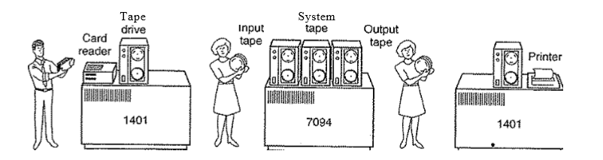
Cont…
The problems with Batch Systems are following.
Lack of interaction between the user and job.
CPU is often idle, because the speeds of the mechanical I/O devices is slower than CPU.
Difficult to provide the desired priority.

Slide 46
Time sharing operating system
Time sharing is a technique which enables many people, located at various terminals(shell), to use a single computer system at the same time.
The processor time (CPU) which is shared among multiple users simultaneously is termed as time sharing.
Time-sharing or multitasking is a logical extension of multiprogramming.
Example: UNIX, Mutics, Linux….

Slide 47
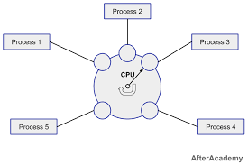

Slide 48
Cont…
Multiple jobs are executed by the CPU by switching between them, but the switches occur so frequently. Thus, the user can receive an immediate response.
Advantages
Provide advantage of quick response.
Avoids duplication of software.
Reduces CPU idle time.
Disadvantages
Problem of reliability.
Question of security and integrity of user programs and data.
Problem of data communication.

Slide 49
Distributed operating system
Distributed systems use many processors located in different machines to provide very fast computation to its users.
Data processing jobs are distributed among the processors accordingly to which one can perform each job most efficiently.
The processors communicate with one another through various communication lines (such as high-speed buses or telephone lines).
These are referred as loosely coupled systems or distributed systems.

Slide 50
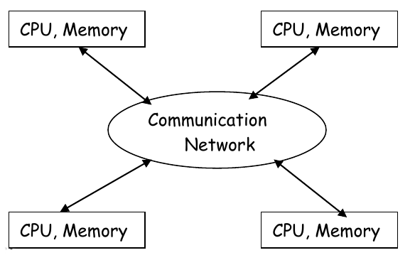

Slide 51
Cont…
Advantages
With resource sharing facility user at one site may be able to use the resources available at another.
Speedup the exchange of data with one another via electronic mail.
If one site fails in a distributed system, the remaining sites can potentially continue operating.
Better service to the customers.
Reduction of the load on the host computer.
Reduction of delays in data processing.

Slide 52
Network operating system
A Network Operating System runs on a server
it provides the server the capability to manage data, users, groups, security, applications, and other networking functions.
The primary purpose of the network operating system is to allow shared file and printer access among multiple computers in a network, typically a local area network (LAN), a private network or to other networks.
Examples of network operating systems are Microsoft Windows Server 2003, Microsoft Windows Server 2008, UNIX, Linux, Mac OS X, Novell NetWare, and BSD

Slide 53
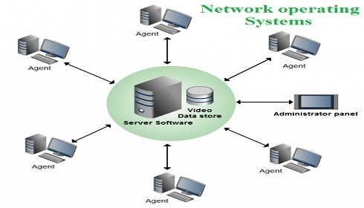

Slide 54
Cont…
Advantage
Centralized servers are highly stable.
Security is server managed.
Upgrades to new technologies and hardware can be easily integrated into the system.
Remote access to servers is possible from different locations and types of systems.
Disadvantage
High cost of buying and running a server.
Dependency on a central location for most operations.
Regular maintenance and updates are required.

Slide 55
Real-time operating system
A real-time system is defined as a data processing system in which the time interval required to process and respond to inputs is so small that it controls the environment.
The time taken by the system to respond to an input and display of required updated information is termed as the response time.
Real-time systems are used when there are rigid time requirements on the operation of a processor or the flow of data and real-time systems can be used as a control device in a dedicated application.
A real-time operating system must have well-defined, fixed time constraints, otherwise the system will fail.
For example, Scientific experiments, medical imaging systems, industrial control systems, weapon systems, robots, air traffic control systems, etc.

Slide 56
Reading assignment
History of OS

Slide 57
Thank you! If you have question, you welcome!

